Slide 1
A MINI PROJECT PRESENTATION On MUSIC PLAYER USING PYTHON
Subject Incharge Name
(Prof. Merlin Priya Jacob)
Submitted By
Soumyojyoti Dutta(19102014)
Moksha Shinde(19102064)
Vedang Gore(19102065)

Slide 2
Abstract
Music player using python is a simple application, modified according to daily needs. Audio is an important source of communication and is as important as text in today’s time. We know that the audio files are digital files. Therefore, there is a need of a tool to run the digital files or in other words, play the files. Thus, we need a music player, which has the capabilities of playing a song, create and display a playlist, pause and resume a long and change the song, that is, play the previous or next song.
Music player is a device using to play MP3s and other digital audio files. We can build this by ourselves without having to download and install premium music players. This program will allow you to play songs and all MP3 files on your desktop or laptops. MP3 player using Python is a basic programming application built using the programming language Python. It is a GUI program built by the means of Python libraries Tkinter, Pygame. This application can be further modified as it develops, adding new features that will make the experience of listening to music even more enjoyable and satisfactory.

Slide 3
Problem Definition
To build an MP3 player using Python programming language to be able to play and listen to songs, MP3 files and other digital audio files.
Determine the functionalities of the MP3 player.
The player should be having a simple and easy to use GUI with options for various functions, display screen to display the entire playlist and buttons to shut down the player.
The player should be able to play any song.
The player should allow the user to browse through the contents of the computer drive to choose song/s to be played or queued.
It should provide the user with option to pause or resume the song.
The user should be able to play the previous or the next song in the playlist.

Slide 4
Description of the modules used
1. TKINTER:
The Tkinter library of Python was used to create the GUI of the project. It was used to create the option buttons, the label and the display area.Tkinter is the standard GUI library for Python. Python when combined with Tkinter provides a fast and easy way to create GUI applications. Tkinter provides a powerful object-oriented interface to the Tk GUI toolkit.
2. PYGAME MODULE:
The Pygame library was used to add songs, play the songs, provide pause and resume options.Pygame is a cross-platform set of Python modules designed for writing video games. It includes computer graphics and sound libraries designed to be used with the Python programming language. Pygame has an inbuilt method called mixer () which provides us intuitive syntax on dealing with sounds files in python, we will see;
Loading and playing music
Pausing and unpausing music
Stopping the music file

Slide 5
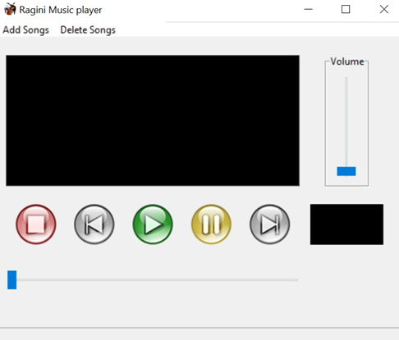
Implementation details with screen-shots (stepwise)

Slide 6
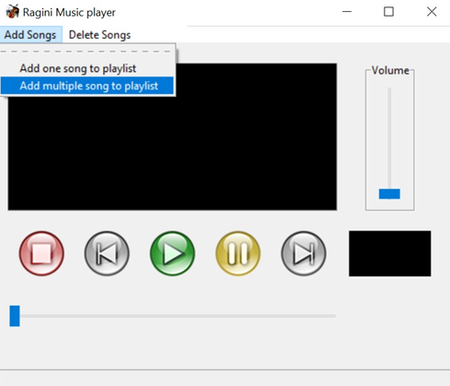

Slide 7
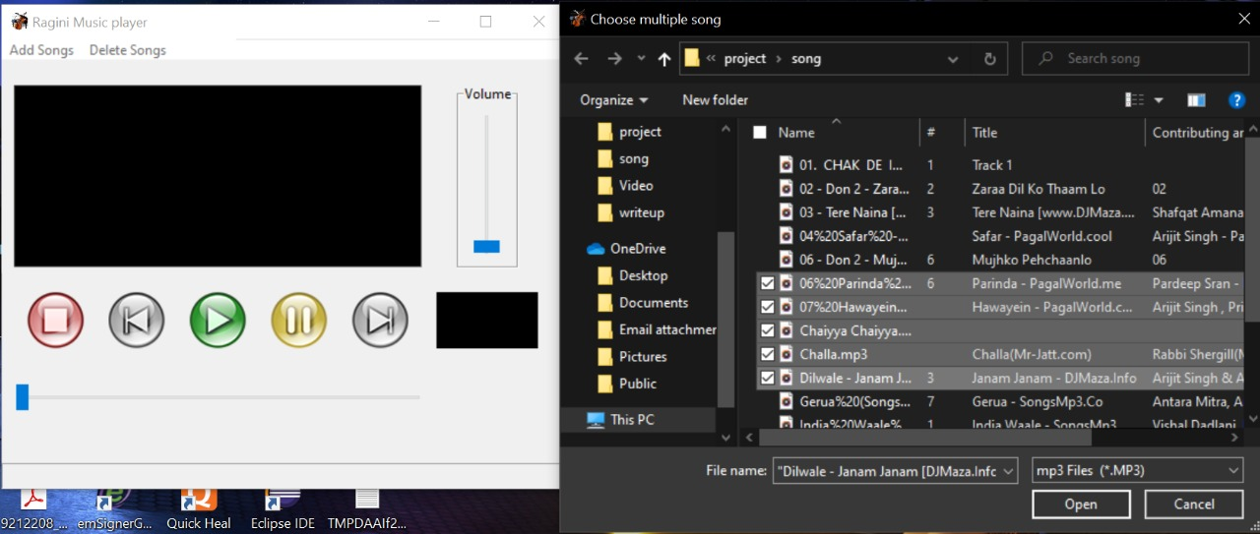

Slide 8
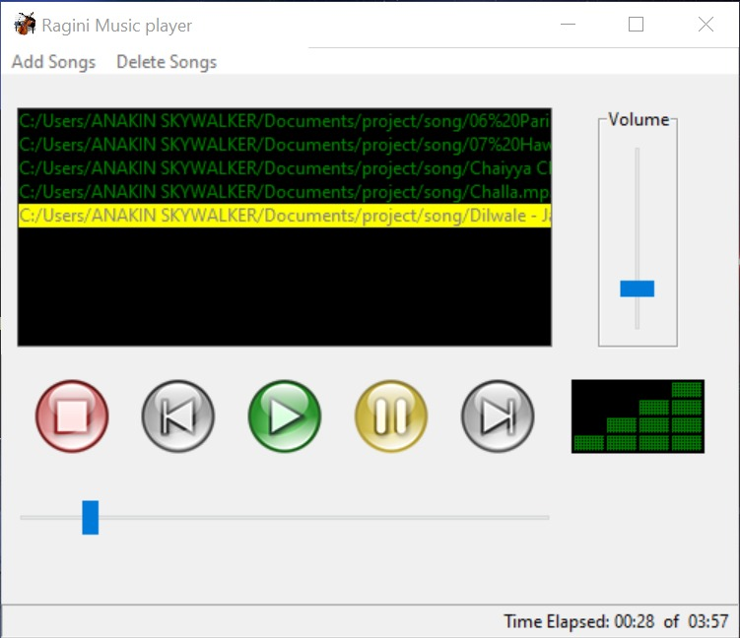

Slide 9
Conclusion and Future Scope
MP3 player is a device built to play and listen to digital audio files. These can be either songs or some other audio files. The player was built using Python language. A GUI implementation of the application was developed that is simple and easy to use.
The application provides the user with five options — to add song to a playlist, to play the song, to pause or resume the song, to play the previous song and to play the next song.
The Tkinter library of Python was used to create the GUI of the project. It was used to create the option buttons, the label and the display area.
The Pygame library was used to play the songs, provide pause and resume options, forward or backward the song.
In conclusion, a successful project was built in which songs will play according to the user's preference.
Future scope: This application can be further improved with the help of advanced GUI knowledge, addition of more buttons like shuffle which will make the experience even more user friendly.

Slide 10
THANK YOU!

